Slide 1







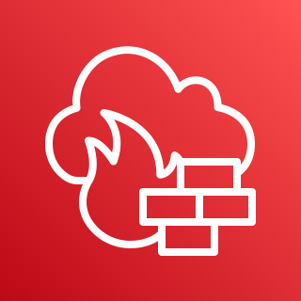





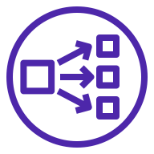
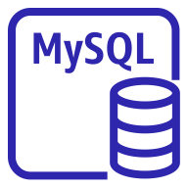









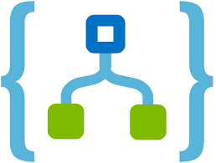

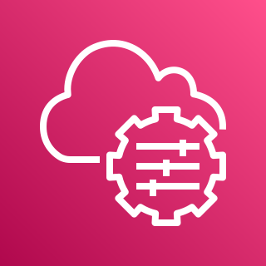
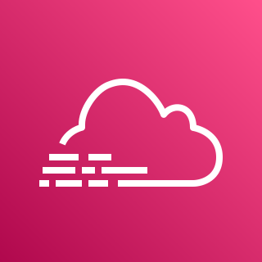













AWS Cloud
AWS Cloud
대전
서울
VPC
VPC
Availability Zone
Public subnet
Security group
Security group
Amazon S3
DB backup
Amazon S3
Log & event backup
EC2 Ubuntu(WEB)
EC2 Ubuntu(WAS)
Private subnet
인터넷
Auto Scaling group
Auto Scaling group
Private subnet
Private subnet
10.0.0.0/24
10.1.0.0/24
DB backup
standby
인터넷 사용자
Availability Zone
c5a.xlarge 2개
t4g.medium 2개
10.2.0.0/24
Security group
EC2 Ubuntu(WEB)
EC2 Ubuntu(WAS)
Private subnet
Auto Scaling group
Auto Scaling group
Private subnet
Private subnet
10.0.0.0/24
10.1.0.0/24
c5a.xlarge 2개
master
(동기화)
t4g.medium 2개
10.2.0.0/24
Azure cloud
Security group
10.2.0.0/24
내부 사용자
Log&event
Azure Security
Center
Log Analysis
workspace
Azure
Sentinel
Playbooks
Azure
리포트
AWS Systems Manager
AWS CloudTrail
AWS Lambda
(Optional)
Collector proxy(VPN)
File Storage
File Server
Amazon CloudWatch
AWS WAF
VPN
Security group
VPN
Private subnet
10.3.0.0/24
(Amazon SNS)
Email
Mobile client

Slide 2




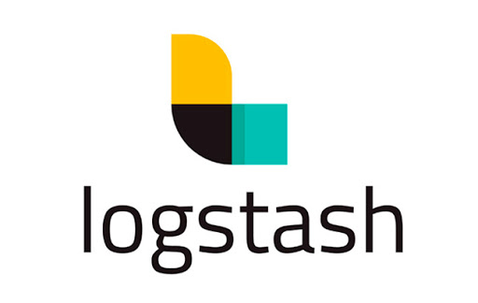
Azure cloud
AWS Cloud
서울
10.2.0.0/24
VPC
Azure Firewall
Azure WAF
Public subnet
Azure
Sentinel
Playbooks
Azure
리포트
File Storage
File Server
Availability Zone
Security group
AWS Cloud
EC2 Ubuntu(WEB)
EC2 Ubuntu(WAS)
Private subnet
대전
Auto Scaling group
Auto Scaling group
VPC
Private subnet
Private subnet
10.0.0.0/24
10.1.0.0/24
Availability Zone
master
Security group
인터넷 사용자
c5a.xlarge 2개
t4g.medium 2개
10.2.0.0/24
EC2 Ubuntu(WEB)
EC2 Ubuntu(WAS)
Private subnet
Auto Scaling group
Auto Scaling group
Private subnet
Private subnet
10.0.0.0/24
10.1.0.0/24
standby
c5a.xlarge 2개
t4g.medium 2개
10.2.0.0/24
Security group
VPN
Role
Amazon CloudWatch
AWS CloudTrail
DB backup
VPN
Log&event
내부 사용자
Security group
Security group
Private subnet
10.3.0.0/24
AWS Lambda
Amazon S3
DB backup
Amazon S3
Log & event backup
Email
(Amazon SNS)

